Slide 1
Java Programming
5

Slide 2
PACKAGES IN JAVA
Package in Java is a mechanism to encapsulate a group of classes, sub packages and interfaces.
Adding a class to a Package : We can add more classes to a created package by using package name at the top of the program and saving it in the package directory. We need a new java file to define a public class, otherwise we can add the new class to an existing .java file and recompile it.
Subpackages: Packages that are inside another package are the subpackages. These are not imported by default, they have to imported explicitly. Also, members of a subpackage have no access privileges, i.e., they are considered as different package for protected and default access specifiers.
Example :
import java.util.*;
util is a subpackage created inside java package

Slide 3
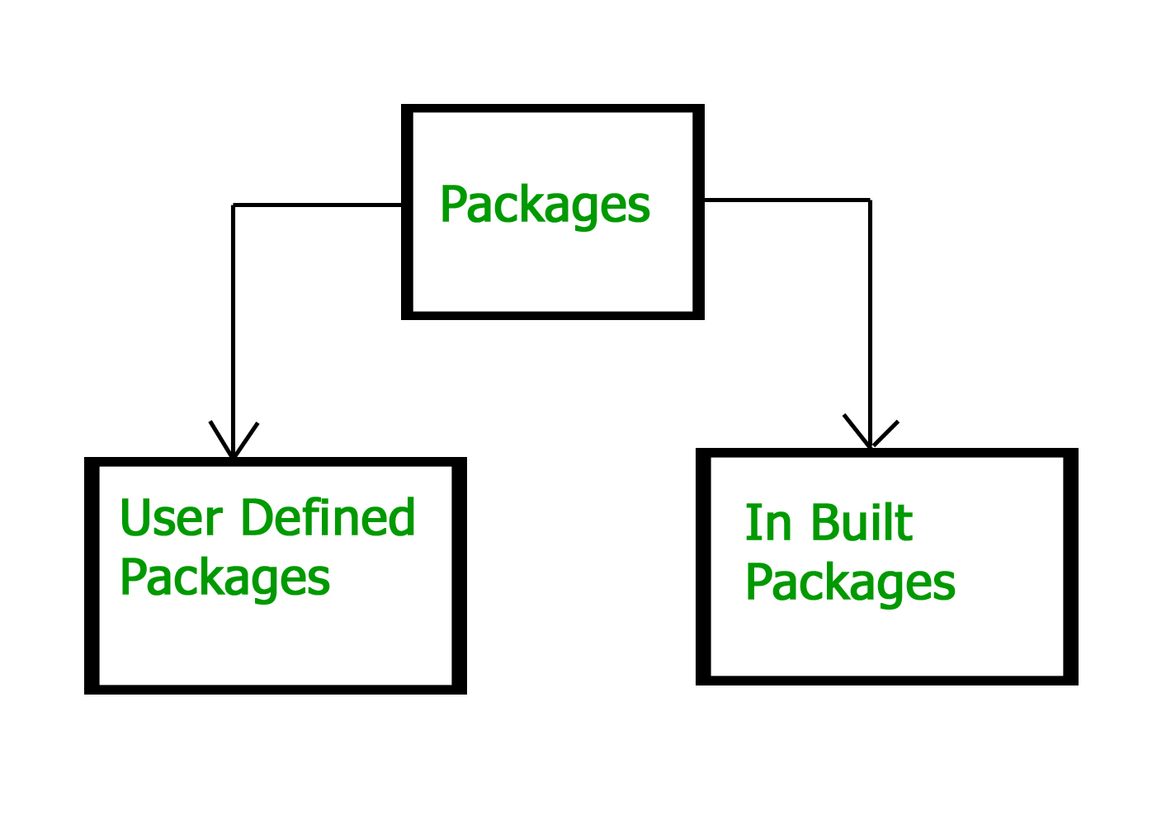
TYPES OF PACKAGES
There are Two Types of Packages:
1.User Defined Package
2.In Built Packages

Slide 4
TYPES OF PACKAGES
Built-in Packages:
These packages consist of a large number of classes which are a part of Java API.Some of the commonly used built-in packages are: 1) java.lang: Contains language support classes(e.g classed which defines primitive data types, math operations). This package is automatically imported. 2) java.io: Contains classed for supporting input / output operations. 3) java.util: Contains utility classes which implement data structures like Linked List, Dictionary and support ; for Date / Time operations. 4) java.applet: Contains classes for creating Applets. 5) java.awt: Contain classes for implementing the components for graphical user interfaces (like button , ;menus etc). 6) java.net: Contain classes for supporting networking operations.

Slide 5
USER DEFINED PACKAGES
These are the packages that are defined by the user.
First we create a directory myPackage (name should be same as the name of the package). Then create the Class Name inside the directory with the first statement being the package names.

Slide 6
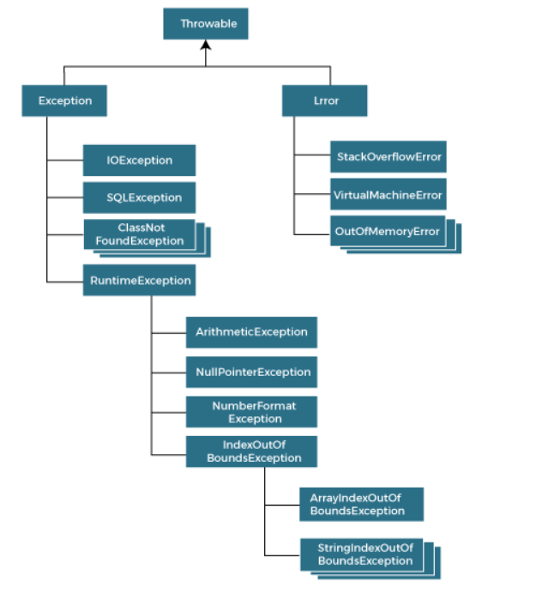
USER DEFINED PACKAGES

Slide 7
EXCEPTION HANDLING
The Exception Handling in Java is one of the powerful mechanism to handle the runtime errors so that the normal flow of the application can be maintained.
In this tutorial, we will learn about Java exceptions, it's types, and the difference between checked and unchecked exceptions.
Exception Handling is a mechanism to handle runtime errors such as ClassNotFoundException, IOException, SQLException, RemoteException, etc.
Advantage of Exception Handling:
The core advantage of exception handling is to maintain the normal flow of the application. An exception normally disrupts the normal flow of the application; that is why we need to handle exceptions.

Slide 8
Difference between Checked and Unchecked Exceptions
Checked Exception
The classes that directly inherit the Throwable class except RuntimeException and Error are known as checked exceptions. For example, IOException, SQLException, etc. Checked exceptions are checked at compile-time.
Unchecked Exception
The classes that inherit the RuntimeException are known as unchecked exceptions. For example, ArithmeticException, NullPointerException, ArrayIndexOutOfBoundsException, etc. Unchecked exceptions are not checked at compile-time, but they are checked at runtime.
Error
Error is irrecoverable. Some example of errors are OutOfMemoryError, VirtualMachineError, AssertionError etc.

Slide 9
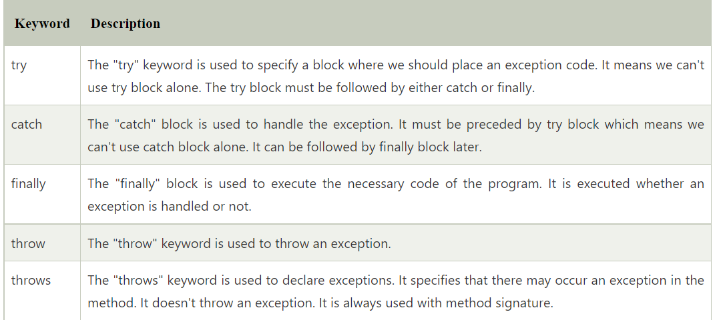
Keywords in Exception Handling

